Slide 1



SESSION NAME HERE
NON - LINEAR DATA STRUCTURES (Part 1)

Slide 2


Foundational Sessions Housekeeping
The use of disrespectful language is prohibited in the questions, this is a supportive, learning environment for all - please engage accordingly. (FBV: Mutual Respect.)
No question is daft or silly - ask them!
There are Q&A sessions midway and at the end of the session, should you wish to ask any follow-up questions. Moderators are going to be answering questions as the session progresses as well.
If you have any questions outside of this lecture, or that are not answered during this lecture, please do submit these for upcoming Open Classes. You can submit these questions here:
SE Open Class Questions or DS Open Class Questions

Slide 3
Foundational Sessions Housekeeping cont.
For all non-academic questions, please submit a query: www.hyperiondev.com/support
Report a safeguarding incident: www.hyperiondev.com/safeguardreporting
We would love your feedback on lectures: Feedback on Lectures

Slide 4


Reminders!
Guided Learning Hours
By now, ideally you should have 7 GLHs per week accrued. Remember to attend any and all sessions for support, and to ensure you reach 112 GLHs by the close of your Skills Bootcamp.
CONFIDENTIAL

Slide 5
Progression Criteria
✅ Criterion 1: Initial Requirements
Complete 15 hours of Guided Learning Hours and the first four tasks within two weeks.
✅ Criterion 2: Mid-Course Progress
Software Engineering: Finish 14 tasks by week 8.
Data Science: Finish 13 tasks by week 8.
✅ Criterion 3: Post-Course Progress
Complete all mandatory tasks by 24th March 2024.
Record an Invitation to Interview within 4 weeks of course completion, or by 30th March 2024.
Achieve 112 GLH by 24th March 2024.
✅ Criterion 4: Employability
Record a Final Job Outcome within 12 weeks of graduation, or by 23rd September 2024.
CONFIDENTIAL

Slide 6

Trees
Binary Trees
Binary Search Trees
B-Trees

Slide 7

The Role of Binary and Rose Trees in Data Organisation
Consider an e-commerce platform with an extensive product catalog organised hierarchically.
Challenges
Efficient searching and updating products.
Managing complex hierarchical relationships between products and categories.

Slide 8
Solution with Binary Trees
Ideal for sorted data.
Operations like search, insert, and delete can be optimised.
Solution with Rose Trees
Perfect for representing multi-level hierarchies.
Can handle multiple child nodes per parent, reflecting complex relationships.
Real-World Impact: Improved performance in querying and managing hierarchical data, essential for a seamless user experience on the platform.

Slide 9

Example: Visualising Binary Tree
Throughout the lecture we’ll use the phrases “Binary Tree” and “Binary Search Tree” interchangeably, but our focus is on the commonly used Binary Search Tree which has differences to the Binary Tree and will be explained in a few slides
Let’s use a tool developed by VISUALGO.NET to show dynamic visualisations (as documented in the slides for convenience 🙂)

Slide 10
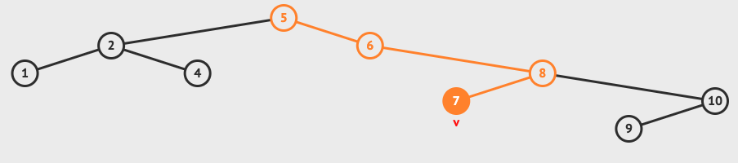
Let’s assume we have products with ids {5, 6, 2, 1, 8, 10, 9, 4, 7} that were received in this order and need to be documented
Notice if we search for 7, we’ll search a total of 3 nodes before finding it, instead of through a set of 9 elements. Similarly, inserts and deletes are more efficient. For massive datasets this becomes indispensable to a large company

Slide 11
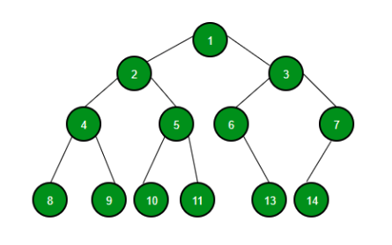
Binary Trees
A tree structure where each node has at most two children
Properties
Hierarchical structure with a single root.
Each node has zero, one, or two children.
Source: GeeksForGeeks

Slide 12
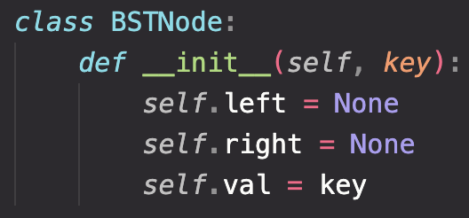
Binary Search Trees (BSTs)
A type of binary tree where each node has a key, and every node's key is greater than all keys in its left subtree and less than all keys in its right subtree.
Here is the implementation of a single node in a BST, which will be useful to demonstrate the functions in the coming slides

Slide 13
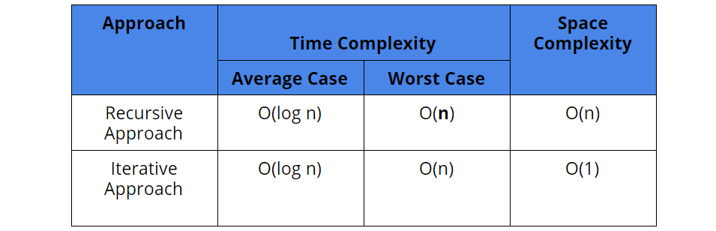

Slide 14
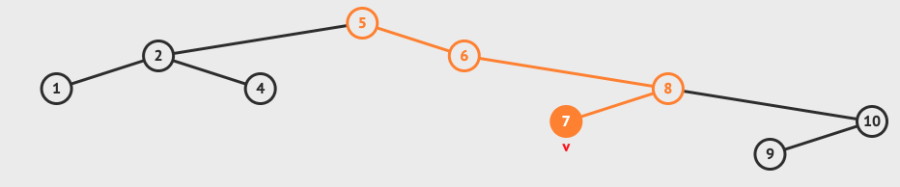
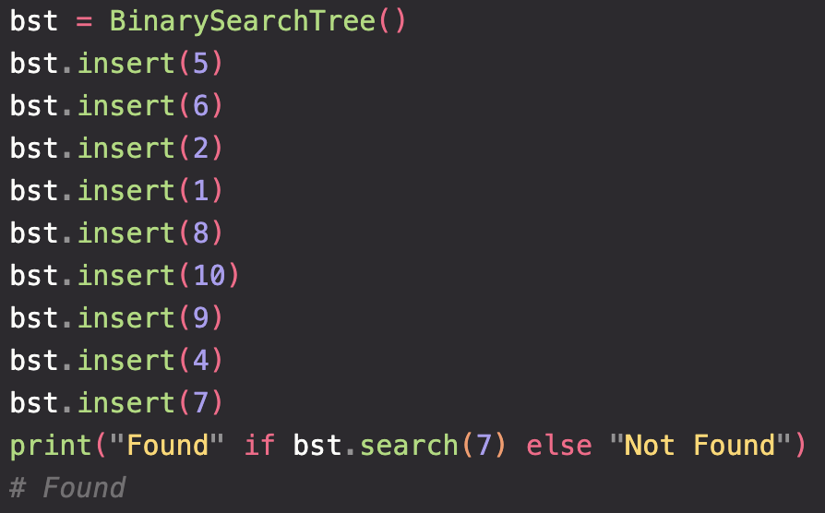
For example, let’s create a BST from {5, 6, 2, 1, 8, 10, 9, 4, 7} and verify that 7 is in the tree, like the example at the start

Slide 15
B-Trees
A type of balanced tree data structure, commonly used in databases and file systems. They are a specialized form of a rose tree, where each node can have multiple children
Properties:
Each node in a B-Tree can have several children, determined by the tree's order.
Nodes keep data in sorted order, facilitating efficient access and insertion.
Automatically balances itself to maintain a low height.

Slide 16
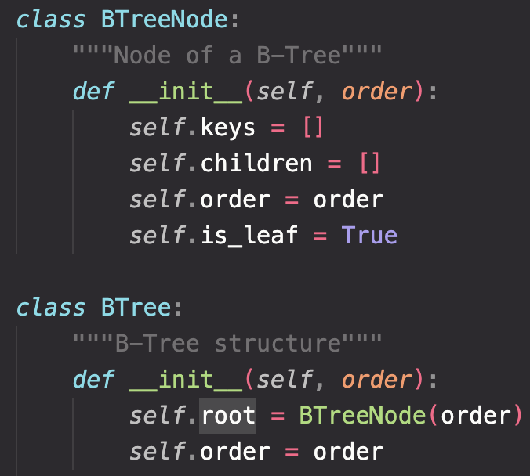
B-Tree Node and B-Tree Constructor
Disclaimer: Some complicated functions are omitted because they do not aid in understanding. Feel free to check it out in the script. In practice you would use pre-built libraries to implement these structures, but for better understanding implementing from scratch is a great exercise.

Slide 17
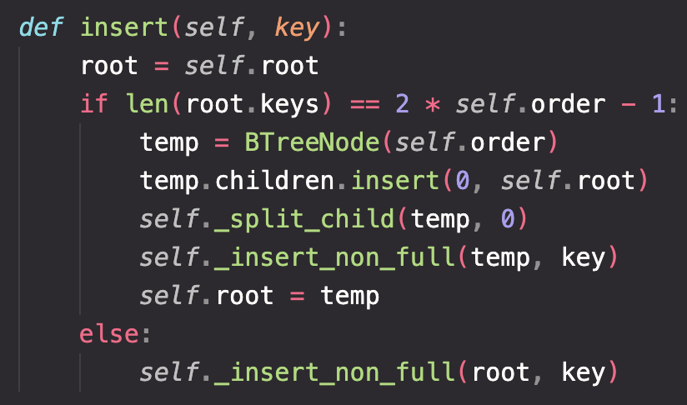
Insert Function
Inserts a new key into the B-Tree. If the node is full (determined by the order), it splits the node and then inserts the key in the correct position.
Time Complexity: O(log n), each insertion may require traversing from root to leaf and possibly splitting nodes.
Space Complexity: O(1), no added space required.

Slide 18
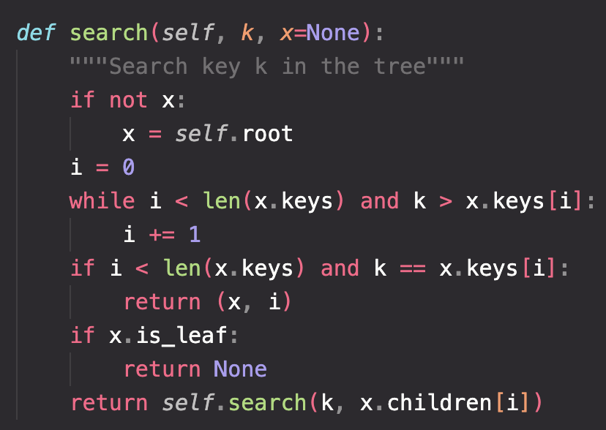
Search Function
Searches for a key by traversing down the tree nodes. It efficiently narrows down the search path at each node.
Time Complexity: O(log n), the search operation traverses from root to leaf, quickly narrowing down the search space.
Space Complexity: O(1), no added space required.

Slide 19
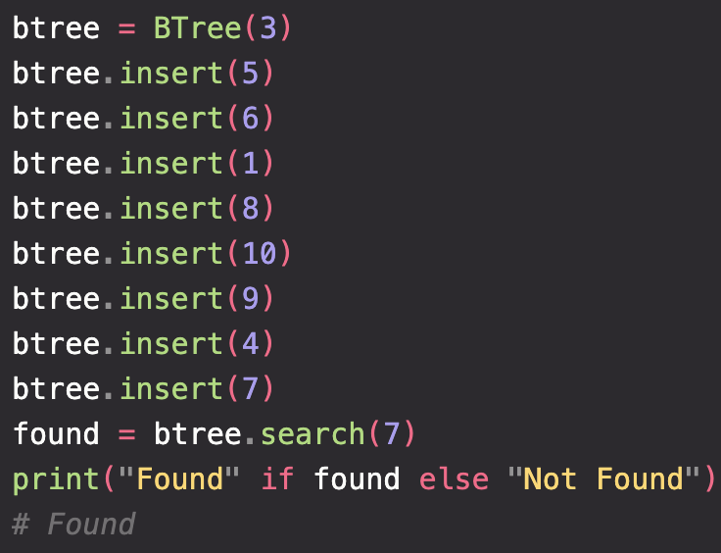
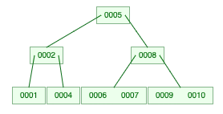
For example, let’s create a B-Tree from ids {5, 6, 2, 1, 8, 10, 9, 4, 7} and verify that id 7 is in the tree, like the example at the start:

Slide 20


Thank you
for joining us
Take regular breaks
Stay hydrated
Avoid prolonged screen time
Practice good posture
Get regular exercise
“With great power comes great responsibility”

Slide 21


Questions and Answers
Questions around Non-Linear Data Structures Part 1

